Slide 1
Machine Learning

Slide 2
What is artificial intelligence?
Artificial intelligence is a broad field, which refers to the use of technologies to build machines and computers that have the ability to mimic cognitive functions associated with human intelligence, such as being able to see, understand, and respond to spoken or written language, analyze data, make recommendations, and more.
The main goal of Artificial Intelligence is to develop self-reliant machines that can think and act like humans.
These machines can mimic human behavior and perform tasks by learning and problem-solving.
Most of the AI systems simulate natural intelligence to solve complex problems.

Slide 3
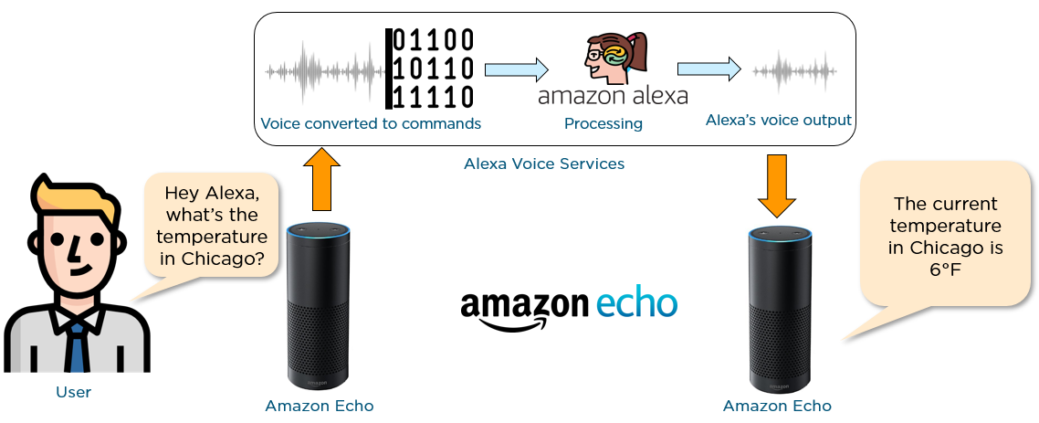
Let’s have a look at an example of an AI-driven product - Amazon Echo.
Other examples of AI
Machine Translation such as Google Translate
Self Driving Vehicles such as Google’s Waymo
AI Robots such as Sophia and Aibo
Speech Recognition applications like Apple’s Siri or OK Google

Slide 4
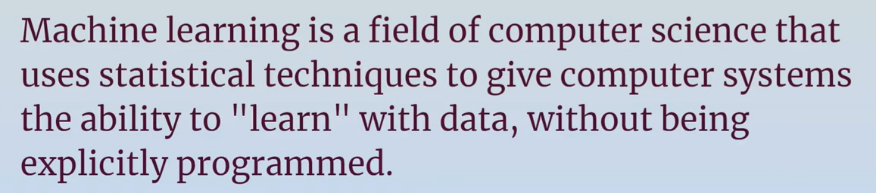
Definition

Slide 5
What is Machine Learning?
Machine learning is a subset of artificial intelligence that automatically enables a machine or system to learn and improve from experience. Instead of explicit programming, machine learning uses algorithms to analyze large amounts of data, learn from the insights, and then make informed decisions.
Machine learning algorithms improve performance over time as they are trained—exposed to more data. Machine learning models are the output, or what the program learns from running an algorithm on training data. The more data used, the better the model will get

Slide 6
Why use Machine Learning?
When building non-learners, we usually follow these steps:
We make rules
We write an algorithm
If the algorithm performs well, we deploy. If not, we go back to step 1
However, if the problem is complex, we'll likely endup with a long list of rules that are hard to maintain and scale to other similar problems.
An ML system would be much shorter, easier to maintain, and in many cases, more accurate.

Slide 7
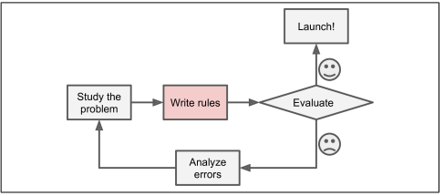
Traditional approach vs ML
Steps for Spam Detection Using Pattern Recognition
Analyze Spam Characteristics:
Identify common words/phrases (e.g., "4U," "credit card," "free," "amazing").
Observe patterns in sender names, email bodies, etc.
Develop Detection Algorithms:
Create algorithms to detect identified patterns.
Flag emails as spam based on pattern matches.
Iterate and Refine:
Test the detection algorithm.
Continuously refine the algorithm for better accuracy.
spam filter using traditional programming techniques
Since the problem is not trivial, your program will likely become a long list of com‐ plex rules—pretty hard to maintain.

Slide 8
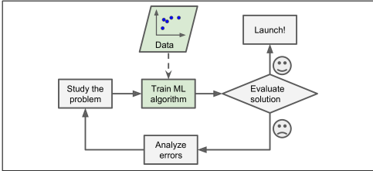
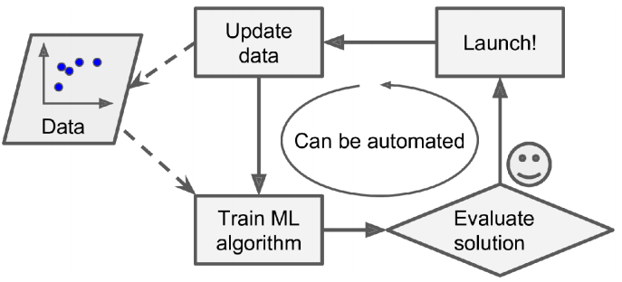
Traditional approach vs ML
Machine Learning-Based Spam Filtering
Automatic Learning:
Detects frequent patterns in spam versus ham examples.
Learns which words/phrases are strong spam indicators.
Results in shorter, easier-to-maintain, and more accurate programs.
Adaptability:
Machine learning models can adapt to new spam tactics (e.g., "4U" to "For U").
Reduces the need for manual updates to detection rules.
Resilience Against Evolving Tactics:
Continually learns from new data, making it harder for spammers to bypass filters.
Higher Accuracy:
More likely to identify spam correctly, reducing false positives and negatives
spam filter using ML
Automatically adapting to change

Slide 9
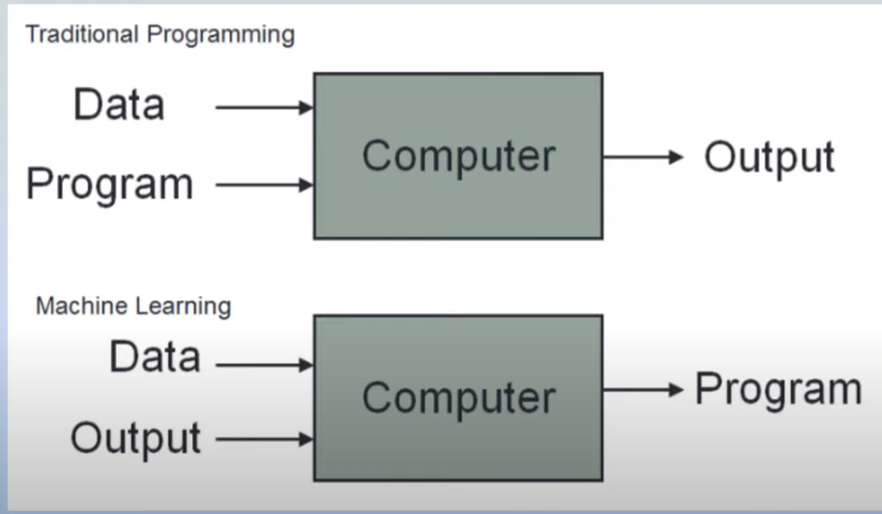
Machine learning algorithms will generate logic.
We need not to generate code for each scenario, that will be handled by ML.

Slide 10
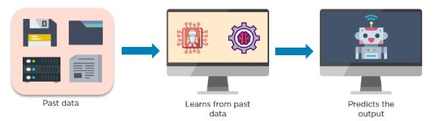
How Does Machine Learning Work?
Machine learning accesses vast amounts of data (both structured and unstructured) and learns from it to predict the future. It learns from the data by using multiple algorithms and techniques. Below is a diagram that shows how a machine learns from data.

Slide 11
Scenarios in which ML is useful
In some cases where you cannot do programming. Example email spam classifier in which you have to write program to classify a email as spam or not spam. Then we will use if else ladder for discount ,huge, sale etc
A very difficult scenario where number of cases will be uncountable that you cannot write them. Example we need to classify whether in picture dog is there or not. How humans learn it by looking at dogs from childhood ,feed it in brain. Basically learning from data
One very important usecase is Data Mining. Data mining is the use of machine learning and statistical analysis to uncover patterns and other valuable information from large data sets.

Slide 12
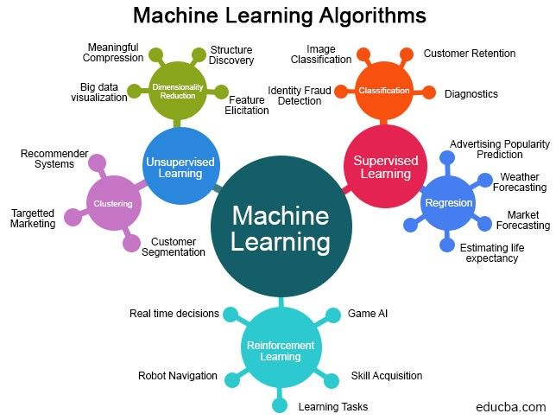

Slide 13
Machine Learning is great for
• Problems for which existing solutions require a lot of hand-tuning or long lists of rules: one Machine Learning algorithm can often simplify code and perform better.
• Complex problems for which there is no good solution at all using a traditional approach: the best Machine Learning techniques can find a solution.
• Fluctuating environments: a Machine Learning system can adapt to new data.
• Getting insights about complex problems and large amounts of data.

Slide 14
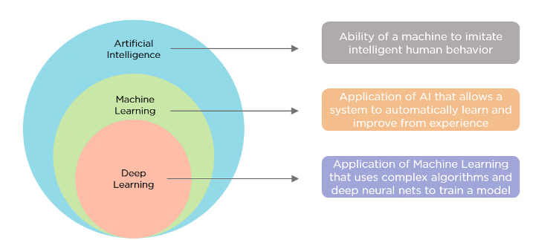
Artificial intelligence (AI) vs. machine learning (ML)

Slide 15
Structured and unstructured data ?

Slide 16
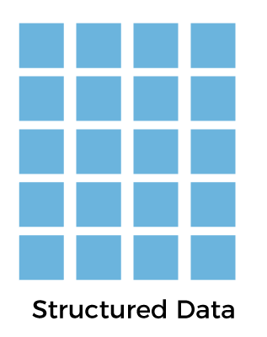
Structured Data
The data which is to the point, factual, and highly organized is referred to as structured data. It is quantitative in nature, i.e., it is related to quantities that means it contains measurable numerical values like numbers, dates, and times.
It is easy to search and analyze structured data. Structured data exists in a predefined format. Relational database consisting of tables with rows and columns is one of the best examples of structured data. Structured data generally exist in tables like excel files and Google Docs spreadsheets. The programming language SQL (structured query language) is used for managing the structured data. SQL is developed by IBM in the 1970s and majorly used to handle relational databases and warehouses.
Structured data is highly organized and understandable for machine language. Common applications of relational databases with structured data include sales transactions, Airline reservation systems, inventory control, and others.

Slide 17

Unstructured Data
All the unstructured files, log files, audio files, and image files are included in the unstructured data. Some organizations have much data available, but they did not know how to derive data value since the data is raw.
Unstructured data is the data that lacks any predefined model or format. It requires a lot of storage space, and it is hard to maintain security in it. It cannot be presented in a data model or schema. That's why managing, analyzing, or searching for unstructured data is hard. It resides in various different formats like text, images, audio and video files, etc. It is qualitative in nature and sometimes stored in a non-relational database or NO-SQL.
It is not stored in relational databases, so it is hard for computers and humans to interpret it. The limitations of unstructured data include the requirement of data science experts and specialized tools to manipulate the data.

Slide 18
Types of Machine Learning Systems
By Supervision:
Supervised Learning: Trained with labeled data.
Unsupervised Learning: No labeled data; finds patterns on its own.
Semi-supervised Learning: Partially labeled data.
Reinforcement Learning: Learns through rewards and punishments.
By Learning Process:
Online Learning: Learns incrementally as new data arrives.
Batch Learning: Learns from the entire dataset at once.
By Approach:
Instance-based Learning: Compares new data points to known ones.
Model-based Learning: Detects patterns and builds a predictive model.

Slide 19
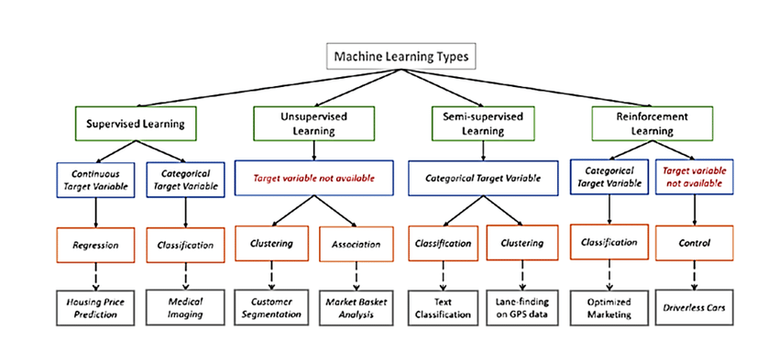
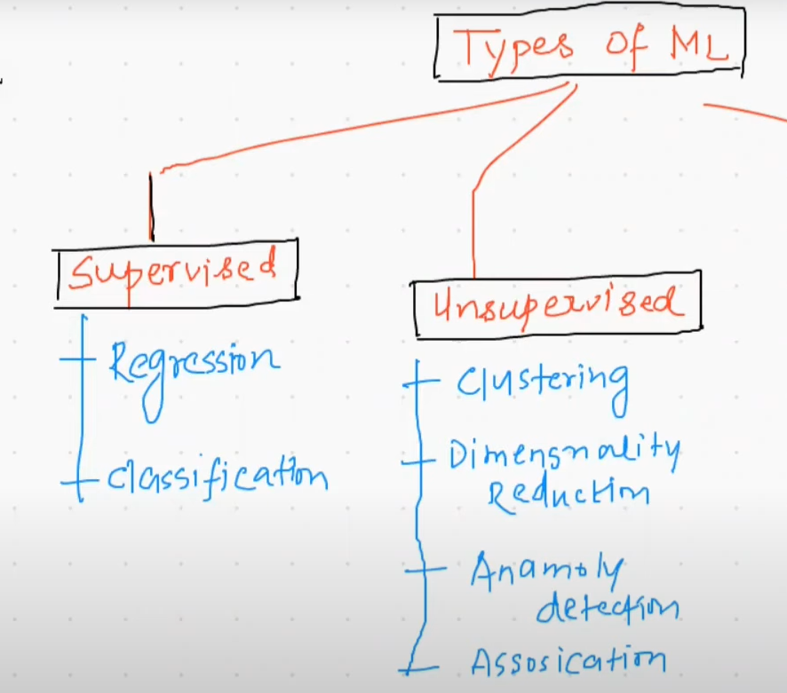
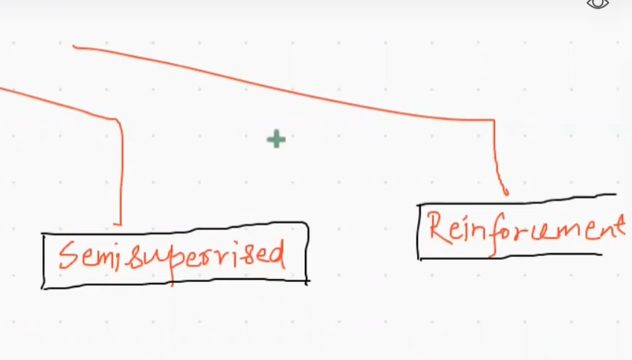
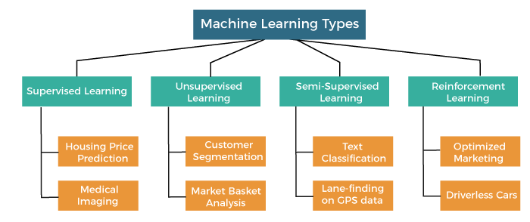
Types of Machine Learning
a. Based on the amount of supervision needed for ML algo to get train

Slide 20
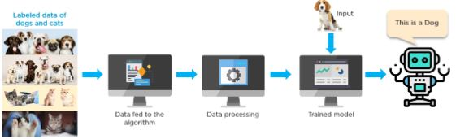
Type of ML
1. Supervised Learning
In supervised learning, the data is already labeled, which means you know the target variable. Using this method of learning, systems can predict future outcomes based on past data. It requires that at least an input and output variable be given to the model for it to be trained.
Below is an example of a supervised learning method. The algorithm is trained using labeled data of dogs and cats. The trained model predicts whether the new image is that of a cat or a dog.
Some examples of supervised learning include linear regression, logistic regression, support vector machines, Naive Bayes, and decision tree.

Slide 21
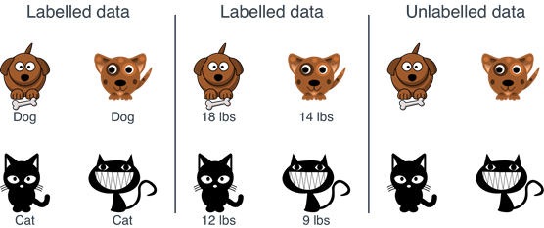
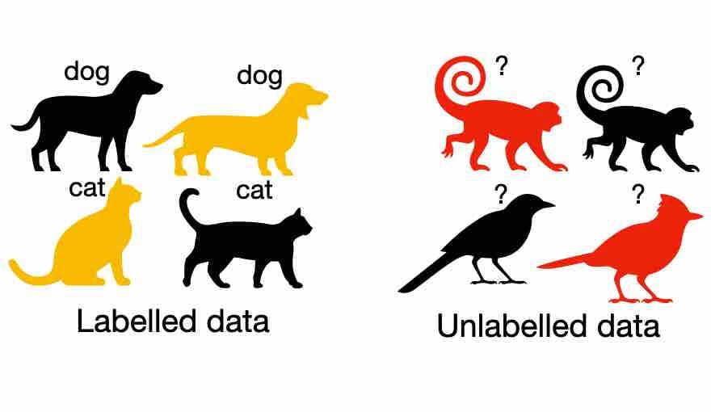
Labelled and unlabeled data

Slide 22
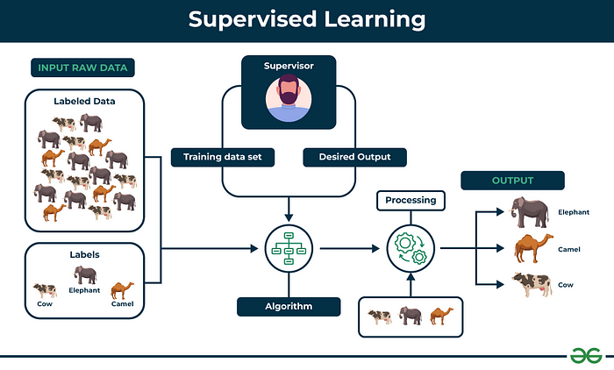
https://www.geeksforgeeks.org/supervised-unsupervised-learning/

Slide 23
Supervised Learning
Definition:
Training data includes desired solutions, known as labels.
The algorithm learns from labeled examples provided by a "supervisor."
Process:
Training: Machine is trained using well-labeled data with correct answers.
Prediction: New examples are provided, and the algorithm uses the learned patterns to predict the correct outcomes.
Goal:
To enable the algorithm to generalize from the labeled data and make accurate predictions on new, unseen data.

Slide 24
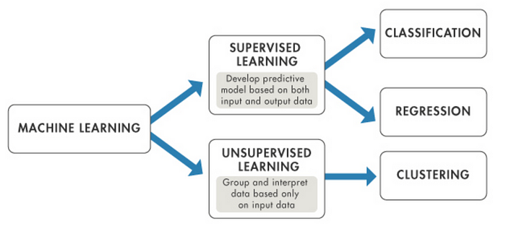
Type of prediction
Image Source:https://www.mathworks.com/help/stats/machine-learning-in-matlab.html

Slide 25
Classification
Purpose:
Predict outcomes based on data features.
Example: A bank predicting if a customer will default on a loan.
Key Components:
Features: Characteristics of the data (e.g., credit history, number of loans).
Target: The outcome to be predicted (e.g., loan repayment status).
Types:
Binary Classification: Two possible outcomes (e.g., Yes/No, 1/0).
Multiclass Classification: More than two possible outcomes.
Common Algorithms:
Logistic Regression
Decision Tree Classifier
K Nearest Neighbor Classifier
Random Forest Classifier
Neural Networks
https://medium.com/@betulsamancii/supervised-vs-unsupervised-learning-630e024093bd

Slide 26
Regression
Purpose:
Predict continuous values rather than categories.
Example: Predicting the price of a house based on its features.
Key Components:
Features: Attributes of the data (e.g., lot size, number of bedrooms, neighborhood).
Target: The continuous value to be predicted (e.g., house price).
Process:
Train an algorithm to understand how features relate to the target value.
Use the trained model to predict values for new data.
Common Algorithms:
Linear Regression
Decision Tree Regressor
K Nearest Neighbor Regressor
Random Forest Regressor
Neural Networks

Slide 27
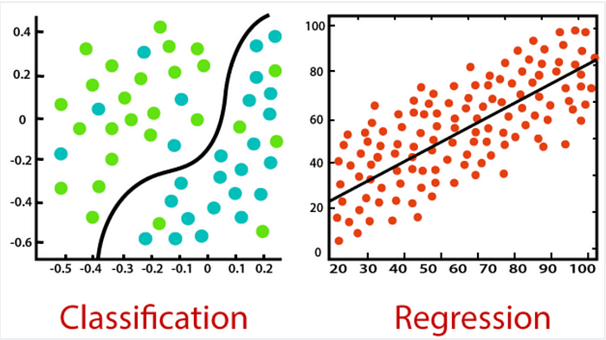
Classification and Regression
Some algorithms can be used for both regression and classification tasks
For example, Logistic Regression is commonly used for classification,
as it can output a value that corresponds to the probability of belonging to a given class (e.g., 20% chance of being spam).
https://static.javatpoint.com/tutorial/machine-learning/images/regression-vs-classification-in-machine-learning.png

Slide 28
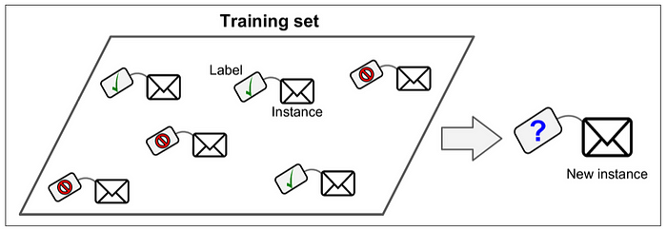
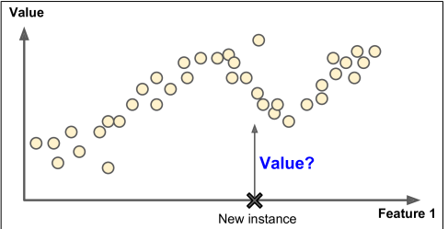
Classification and Regression
Guess the type

Slide 29
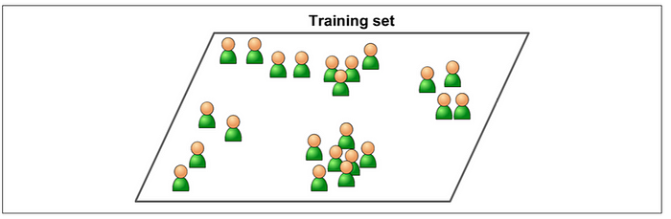
Unsupervised learning
In unsupervised learning, as you might guess, the training data is unlabeled.
The system tries to learn without a teacher.
Unsupervised learning algorithms employ unlabeled data to discover patterns from the data on their own.
The systems are able to identify hidden features from the input data provided.
Once the data is more readable, the patterns and similarities become more evident.
Goal: Discover patterns, relationships, and structures within the data.

Slide 30
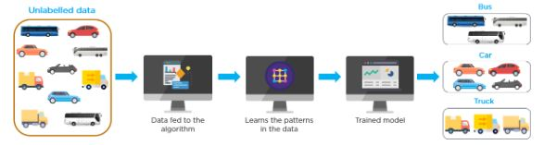
Below is an example of an unsupervised learning method that trains a model using unlabeled data. In this case, the data consists of different vehicles. The purpose of the model is to classify each kind of vehicle.

Slide 31
Unsupervised learning algorithms
• Clustering
— K-Means
— DBSCAN
— Hierarchical Cluster Analysis (HCA)
Anomaly Detection and Novelty Detection — One-class SVM — Isolation Forest
Visualization and Dimensionality Reduction — Principal Component Analysis (PCA) — Kernel PCA — Locally-Linear Embedding (LLE)
Association Rule Learning — Apriori — Eclat

Slide 32
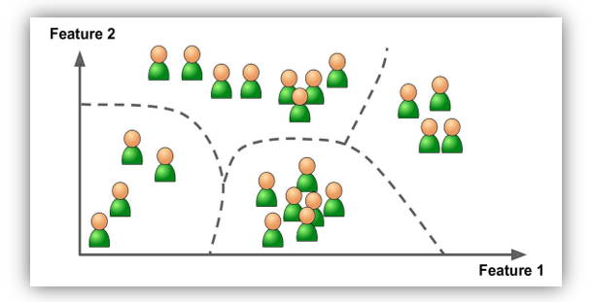
Primary Categories:
1. Clustering:
Groups similar data points into clusters.
Maximizes intra-cluster similarity and minimizes inter-cluster similarity.
Algorithms:
K-Means
DBSCAN
Hierarchical Cluster Analysis (HCA)
Gaussian Mixture Models (GMMs)
Principal Component Analysis (PCA)
Density-Based Spatial Clustering (DBSCAN)
Applications:
Customer segmentation, pattern recognition, anomaly detection
.

Slide 33
2. Association Rule Learning:
Identifies relationships or associations between variables in datasets.
Useful for uncovering patterns like "if X is purchased, Y is also likely.“
Algorithms:
Apriori
Eclat
FP-Growth Algorithm
Applications:
Market basket analysis, recommendation systems, product placement.

Slide 34
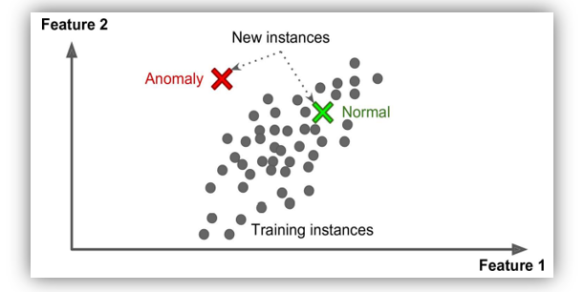
Others category
Anomaly Detection:
Purpose: Identify unusual or outlier instances in data.
Applications:
Detecting fraudulent credit card transactions.
Catching manufacturing defects.
Removing outliers from datasets.
Training: Mostly normal instances are shown; the system learns to recognize normal behavior and flag anomalies.
Tolerance: Can often handle a small percentage of outliers in the training set.
2. Novelty Detection:
Purpose: Identify new or previously unseen data that deviates from known normal patterns.
Training: System is trained only on normal data.
Applications: Often used for detecting new types of anomalies or novel instances that were not present during training.

Slide 35
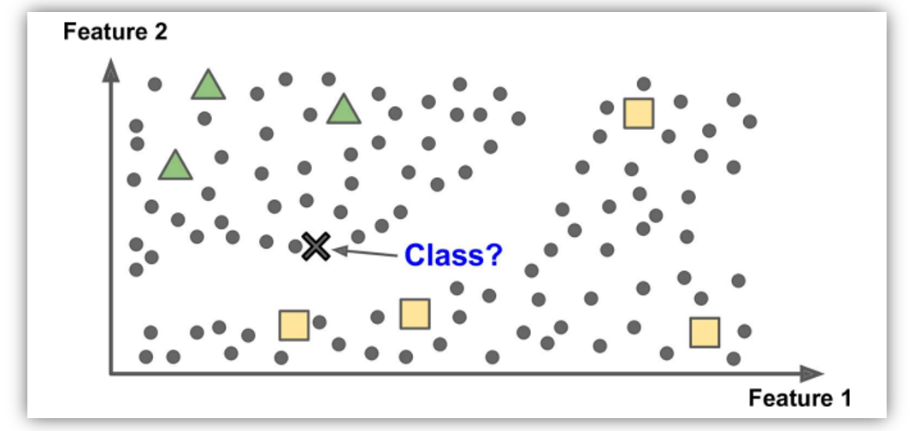
3. Semi-Supervised Learning:-
Definition:
Combines elements of supervised and unsupervised learning.
Utilizes both a limited amount of labeled data and a large amount of unlabeled data.
Training Process:
Labeled Data:
Provides supervision and guidance for the model.
Helps the algorithm learn the relationships between inputs and outputs.
Unlabeled Data:
Allows the model to identify additional patterns and structures in the data.
Enhances the learning process by providing more context beyond the labeled data.
Goal:
Improve model accuracy by leveraging both labeled and unlabeled data.
Develop a better representation of the data, leading to more accurate predictions.

Slide 36
Applications:
Natural Language Processing (NLP): Handling large text corpora where labeling is costly.
Image Classification: Utilizing vast amounts of unlabeled images to improve classification performance.
Medical Diagnosis: Combining limited labeled cases with abundant unlabeled data to enhance diagnostic models.
Advantages:
Reduces the need for extensive labeled datasets, which are often expensive or time-consuming to obtain.
Can lead to better performance compared to using only labeled data due to the richer information from unlabeled data.
Examples of Techniques:
Self-Training: Using the model’s own predictions on unlabeled data to iteratively improve its accuracy.
Co-Training: Using multiple models trained on different features or views of the data to label the unlabeled data and improve each other's performance.
Graph-Based Methods: Constructing a graph where nodes represent data points and edges represent similarities, using this structure to propagate labels from labeled to unlabeled data.

Slide 37
Reinforcement Learning
Definition:
A type of machine learning where an algorithm learns through interaction with an environment.
Receives feedback in the form of rewards or penalties to learn a policy that maximizes cumulative rewards over time.
Process:
Action: The algorithm takes actions in an environment.
Reward Signal: The environment provides feedback based on the quality of actions (rewards for good actions, penalties for bad actions).
Policy: The algorithm learns a mapping from states to actions (policy) that maximizes the total reward.
Goal:
To develop an optimal policy that leads to the highest possible cumulative reward.

Slide 38
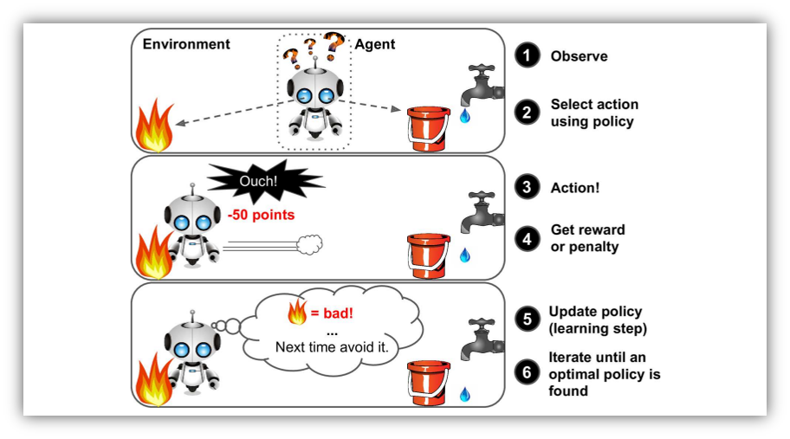
Applications:
Game Playing: Algorithms learn to play games (e.g., chess, Go) by playing repeatedly and learning from rewards and penalties.
Robotics: Robots learn to perform tasks (e.g., walking, grasping objects) by interacting with their environment and improving their actions based on feedback.
Recommendation Systems: Algorithms personalize recommendations by learning from user interactions and feedback.

Slide 39
Key Concepts:
Trial-and-Error Learning: The algorithm learns from its experiences, improving its performance over time through experimentation.
Exploration vs. Exploitation: Balancing between trying new actions (exploration) and using known actions that give high rewards (exploitation).
Reward Function: The design of the reward function influences the behavior and learning efficiency of the algorithm.
Value Function: Estimates the expected reward for a given state or action to guide decision-making.
Challenges:
Designing the Reward Function: Crafting an effective reward function that aligns with the desired outcome can be complex.
Scalability: Reinforcement learning can be computationally intensive and may require extensive training time.
Exploration: Ensuring adequate exploration of the action space to discover optimal strategies can be challenging.

Slide 40
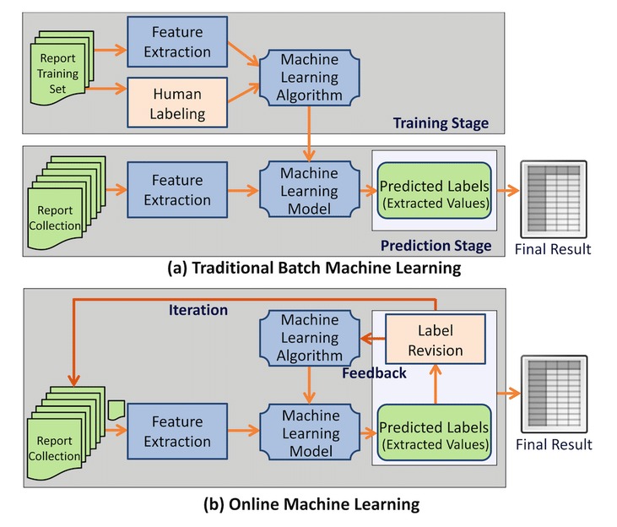
Type of ML
Another criterion used to classify Machine Learning systems is whether or not the system can learn incrementally from a stream of incoming data.
Online vs Batch ML

Slide 41
Batch Learning
Definition:
Machine learning where the model is trained offline on the entire dataset in one go.
Model updates occur in batch mode after processing all training data at once.
Process:
Training: Model is trained once on a fixed dataset.
Prediction: After training, the model is used to make predictions without further updates.
Suitability:
Best for static datasets where data does not change over time.
Useful when training on large datasets is too computationally expensive to process in real-time.

Slide 42
Advantages:
Efficient for large datasets when offline training is feasible.
Training can be done in parallel, utilizing significant computational resources.
Disadvantages:
Adaptability: Model does not adapt to changes in the data distribution over time.
Re-training: New models must be trained from scratch if data distribution changes, which can be time-consuming and computationally expensive.
Applications:
Natural Language Processing (NLP)
Computer Vision
Recommendation Systems
Quality:
Depends on the quality and quantity of training data and choice of algorithms.

Slide 43
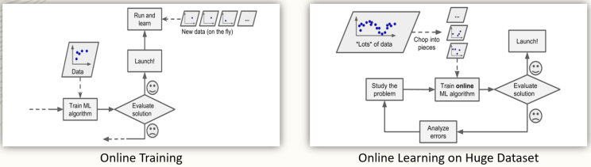
https://www.linkedin.com/pulse/types-machine-learning-techniques-training-method-based-sharma
Online Learning
Definition:
Machine learning where the model is updated incrementally as new data arrives in real-time.
Training occurs on small subsets of data, with continuous updates as new data is received.
Process:
Training: Model is trained on a small subset of data, updated continuously with new data.
Adaptation: Model adapts to changes in data distribution over time.
Suitability:
Ideal for streaming data and scenarios where data distribution changes frequently.
Useful for applications with evolving data, such as financial market analysis, real-time recommendations, and customer behavior analysis.

Slide 44
Advantages:
Adaptability: Model can learn and adapt to changes in data distribution over time.
Efficiency: Computationally efficient as only a subset of data is processed at any time.
Disadvantages:
Algorithm Choice: Performance depends on the choice of online learning algorithms and their update rules.
Data Management: Requires efficient handling of data streams and updates.
Applications:
Financial Market Analysis
Customer Behavior Analysis
Real-time Recommendation Systems
Quality:
Depends on the size of the data subset used for training, the rate of new data arrival, and the algorithm's effectiveness.

Slide 45
Instance-Based Versus Model-Based Learning
One more way to categorize Machine Learning systems is by how they generalize.
Most Machine Learning tasks are about making predictions.
This means that given a number of training examples, the system needs to be able to generalize to examples it has never seen before.
Having a good performance measure on the training data is good, but insufficient; the true goal is to perform well on new instances.

Slide 46
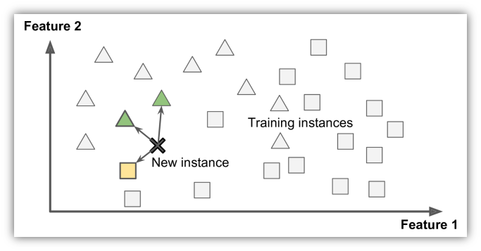
Instance-Based
Definition:
A machine learning approach where the model learns from examples by storing them and then making predictions based on the similarity of new examples to these stored instances.
Predictions are made by comparing new instances to the stored instances using a similarity measure.
Process:
Storage: The system memorizes training examples (e.g., known spam emails).
Similarity Measure: When a new example (e.g., a new email) needs to be classified, it is compared to stored instances using a similarity metric (e.g., word overlap).
Classification: The new example is classified based on the class of the most similar stored instances (e.g., if most similar instances are spam, the new email is flagged as spam).

Slide 47
Spam Filter Example:
Basic Approach: The filter flags emails that are identical to known spam emails.
Improved Approach: The filter flags emails that are similar to known spam emails using a similarity measure.
Similarity Measure: One simple measure is to count the number of common words between the new email and known spam emails.
Classification Rule: If the new email shares many words with known spam, it is flagged as spam.
Characteristics:
Lazy Learning: The model does not learn a general rule but instead stores and compares individual examples.
Computational Cost: The cost is incurred at prediction time, as similarity comparisons are made on-the-fly.
No Explicit Model: The system relies on stored instances and does not create a general model during training.

Slide 48
Advantages:
Simplicity: Easy to implement and understand.
Flexibility: Can handle noisy or irrelevant features as the prediction relies on similar instances rather than a fixed model.
Disadvantages:
Scalability: May become inefficient with large datasets due to the need to compare each new instance to many stored instances.
Prediction for Outliers: May struggle with instances significantly different from stored examples.
No Generalization: The system only generalizes based on the similarity of stored instances and does not create a generalized model.
Example Visualization: (refer fig)
Figure Example: A new instance is classified based on the majority class of the most similar instances (e.g., a new shape classified as a triangle because most similar shapes are triangles).

Slide 49
Applications:
Classification: Assigning class labels based on the majority class of similar instances (e.g., k-Nearest Neighbors).
Regression: Predicting values based on the average or weighted average of similar instances.
Anomaly Detection: Identifying outliers by comparing new instances to stored normal instances.
Examples:
k-Nearest Neighbors (k-NN): Classifies new instances based on the majority vote of the k closest stored instances.
Case-Based Reasoning: Uses past cases or experiences to solve new problems.

Slide 50
Model Based
Definition:
Machine learning approach where a mathematical model is explicitly learned from training data to map inputs to outputs.
The learned model is then used to make predictions on new data.
Process:
Training: A model is trained on a dataset to learn a mapping from inputs to outputs.
Prediction: The trained model is used to predict outcomes for new, unseen data based on the learned mapping.
Characteristics:
Generalization: The model generalizes from the training data, allowing it to make predictions for inputs that differ from those in the training set.
Model Definition: Involves defining and learning a model structure (e.g., linear regression, decision trees, neural networks)

Slide 51
Advantages:
Adaptability: Can make predictions for new inputs that are not present in the training set.
Interpretability: Some models (e.g., linear regression, decision trees) offer clear insights into the relationship between inputs and outputs.
Efficiency: Once trained, predictions can be made quickly without needing to reference the entire training dataset.
Disadvantages:
Complexity: Models may not always capture complex, non-linear relationships accurately.
Overfitting: Risk of overfitting to the training data, especially with complex models and small datasets.
Training Time: Some models (e.g., neural networks) can be computationally expensive to train.
Applications:
Regression: Predicting continuous values (e.g., house prices, temperature).
Classification: Assigning categorical labels (e.g., spam detection, image classification).
Time Series Forecasting: Predicting future values based on past data (e.g., stock prices, weather forecasting).

Slide 52
Types of Models:
Linear Models: (e.g., Linear Regression, Logistic Regression) Model the relationship as a linear function of the inputs.
Decision Trees: Partition the input space into regions based on feature values, making predictions based on majority class or average value in each region.
Neural Networks: Learn complex, non-linear mappings using multiple layers of interconnected nodes (neurons).
Support Vector Machines: Classify data by finding the hyperplane that best separates different classes.

Slide 53
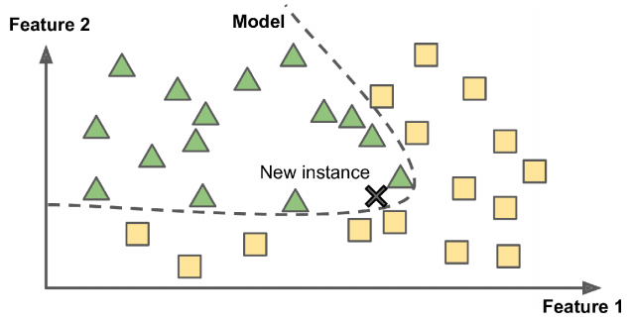
Model-based learning

Slide 54
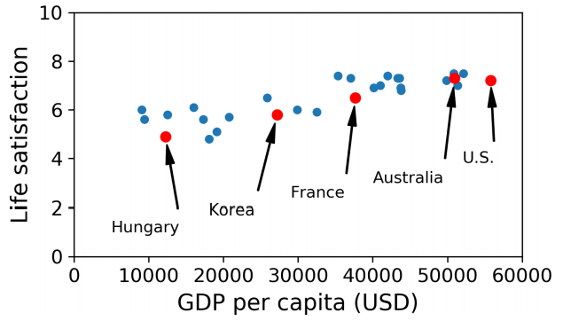
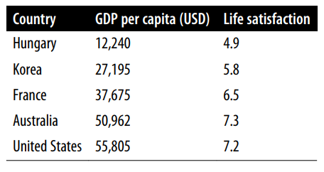
Model based
Example-
Suppose you want to know if money makes people happy, so you download the Better Life Index data from the OECD’s website and stats about gross domestic product (GDP) per capita from the IMF’s website. Then you join the tables and sort by GDP per capita.

Slide 55
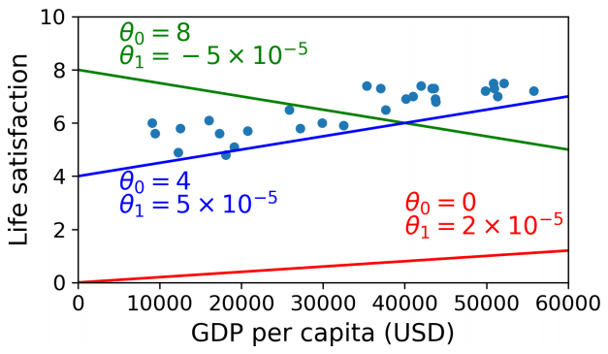
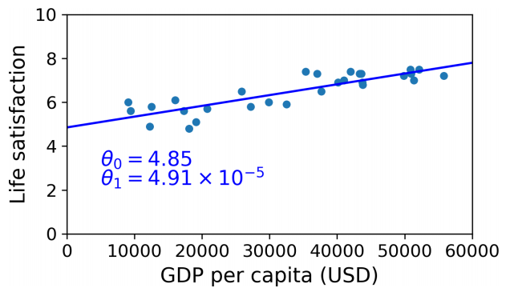
Although the data is noisy (i.e., partly random), it looks like life satisfaction goes up more or less linearly as the country’s GDP per capita increases.
So you decide to model life satisfaction as a linear function of GDP per capita.
This step is called model selection:
linear model of life satisfaction with just one attribute, GDP per capita.
life_satisfaction = θ0 + θ1 × GDP_per_capita
This model has two model parameters, θ0 and θ1. By tweaking these parameters, you can make your model represent any linear function, as shown
A few possible linear models
Discuss code 01
Final model

Slide 56
Main Challenges of Machine Learning
Data
Insufficient Quantity of Training Data
Nonrepresentative Training Data
Poor-Quality Data
Irrelevant Features

Slide 57
Bad algo
Overfitting the Training Data
Underfittin the Training Data

Slide 58
Testing and Validation
The only way to know how well a model will generalize to new cases is to actually try it out on new cases.
One way to put your model in production and monitor how well it performs.
This works well, but if your model is horribly bad, your users will complain—not the best idea.
A better option is to split your data into two sets: the training set and the test set.
As these names imply, you train your model using the training set, and you test it using the test set.
The error rate on new cases is called the generalization error (or out-of sample error), a
nd by evaluating your model on the test set, you get an estimate of this error.
This value tells you how well your model will perform on instances it has never seen before.
If the training error is low (i.e., your model makes few mistakes on the training set)
but the generalization error is high, it means that your model is overfitting the training data
It is common to use 80% of the data for training and hold out 20% for testing. However, this depends on the size of the dataset: if it contains 10 million instances, then holding out 1% means your test set will contain 100,000 instances: that’s probably more than enough to get a good estimate of the generalization error.

Slide 59
Hyperparameter Tuning and Model Selection

Slide 60
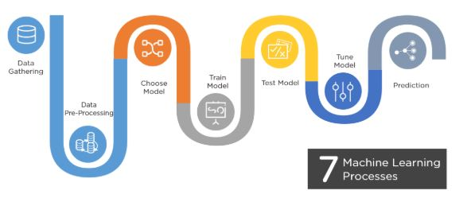
Machine Learning Processes

Slide 61
How are AI and ML connected?
While AI and ML are not quite the same thing, they are closely connected. The simplest way to understand how AI and ML relate to each other is:
AI is the broader concept of enabling a machine or system to sense, reason, act, or adapt like a human
ML is an application of AI that allows machines to extract knowledge from data and learn from it autonomously
One helpful way to remember the difference between machine learning and artificial intelligence is to imagine them as umbrella categories. Artificial intelligence is the overarching term that covers a wide variety of specific approaches and algorithms. Machine learning sits under that umbrella, but so do other major subfields, such as deep learning, robotics, expert systems, and natural language processing

Slide 62
Differences between AI and ML
While artificial intelligence encompasses the idea of a machine that can mimic human intelligence, machine learning does not. Machine learning aims to teach a machine how to perform a specific task and provide accurate results by identifying patterns.
Let’s say you ask your Google Nest device, “How long is my commute today?” In this case, you ask a machine a question and receive an answer about the estimated time it will take you to drive to your office. Here, the overall goal is for the device to perform a task successfully—a task that you would generally have to do yourself in a real-world environment (for example, research your commute time).
In the context of this example, the goal of using ML in the overall system is not to enable it to perform a task. For instance, you might train algorithms to analyze live transit and traffic data to forecast the volume and density of traffic flow. However, the scope is limited to identifying patterns, how accurate the prediction was, and learning from the data to maximize performance for that specific task.

Slide 63
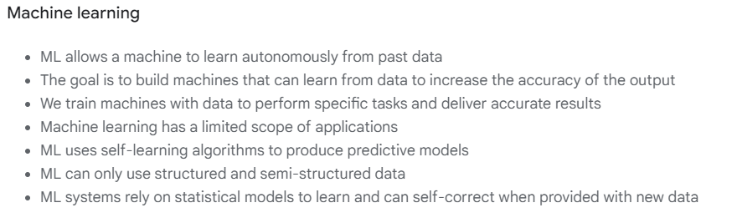
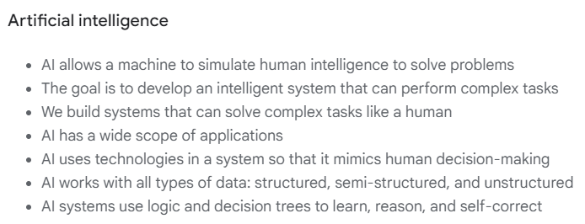

Slide 64
Benefits of using AI and ML together
AI and ML bring powerful benefits to organizations of all shapes and sizes, with new possibilities constantly emerging. In particular, as the amount of data grows in size and complexity, automated and intelligent systems are becoming vital to helping companies automate tasks, unlock value, and generate actionable insights to achieve better outcomes.

Slide 65
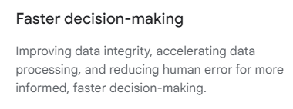
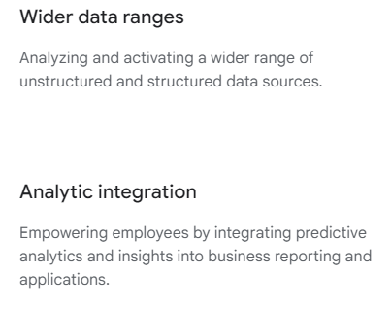
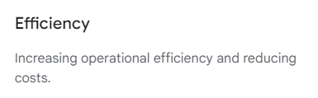
Here are some of the business benefits of using artificial intelligence and machine learning:

Slide 66
Applications of AI and ML
Artificial intelligence and machine learning can be applied in many ways, allowing organizations to automate repetitive or manual processes that help drive informed decision-making.
Companies across industries are using AI and ML in various ways to transform how they work and do business. Incorporating AI and ML capabilities into their strategies and systems helps organizations rethink how they use their data and available resources, drive productivity and efficiency, enhance data-driven decision-making through predictive analytics, and improve customer and employee experiences.

Slide 67
Here are some of the most common applications of AI and ML:
Healthcare and life sciences
Patient health record analysis and insights, outcome forecasting and modeling, accelerated drug development, augmented diagnostics, patient monitoring, and information extraction from clinical notes.
Manufacturing
Production machine monitoring, predictive maintenance, IoT analytics, and operational efficiency.
Ecommerce and retail
Inventory and supply chain optimization, demand forecasting, visual search, personalized offers and experiences, and recommendation engines.
Financial services
Risk assessment and analysis, fraud detection, automated trading, and service processing optimization.
Telecommunications
Intelligent networks and network optimization, predictive maintenance, business process automation, upgrade planning, and capacity forecasting.

